Slide 1
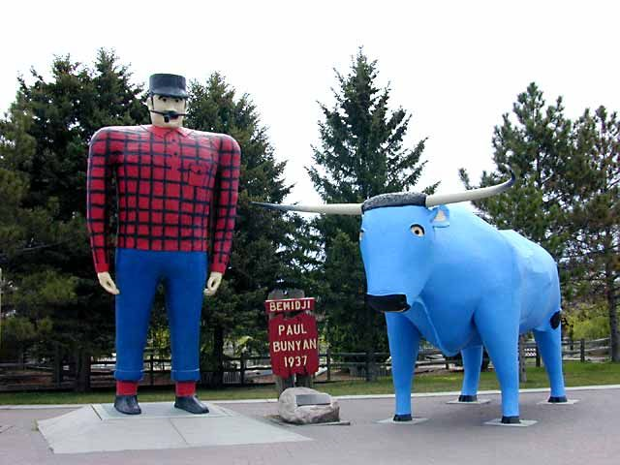
State and University Partnerships:
Models for Education and Training Collaboratives

Slide 2
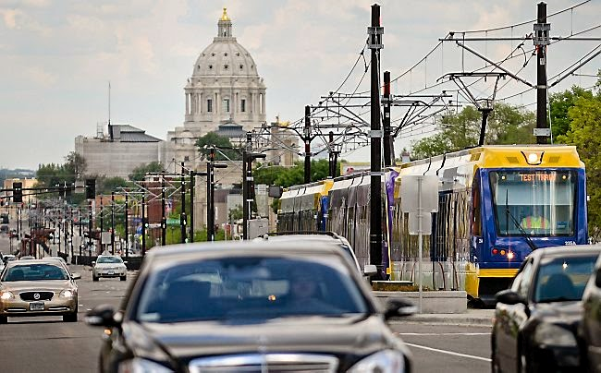
Introductions
Tracy Crudo, Supervisor
Minnesota Department of Human Services
Child Welfare Training System
Liz Snyder, Director of Professional Education
Center for Advanced Studies in Child Welfare,
School of Social Work,
University of Minnesota
Notes:
Photo of University Ave – the street that connects the University and the Capitol

Slide 3
The long and winding road . . .
a history of the partnership
Notes:
As is the case for many partnerships ours has not been a clear line from past to present, but more of a long and winding road
Training system began at the University, regional training model with area trainers
In 2007, the contract was awarding to Century college to expand and develop online offerings
Within 2 years contract was brought in house, to DHS, and a hybrid (online/in class) model for foundation training was developed
Motivations for meaningful partnership =
attempt to rebuild bridge between programs begins

Slide 4
Building bridges . . .
integrating education and training
Notes:
Having the education vs. training debate
The first major project of the collaboration integrating foundation training into IVE undergrad
Students complete 1st 6 WBTs and Classroom 1 (3 days) during field placement
Starting in Fall 2014, IVE graduate field incorporated all 13 WBTs and Classroom 2 and 3
Grad students in this program are exempted from Classroom 1 and graduate with a certificate allowing them to start a county/tribal CW position already having completed foundation training
This was a major accomplishment and is a huge marketing tool for our students seeking employment in counties/tribes
Stone Arch Bridge, Minneapolis
The Stone Arch Bridge is the only bridge of its kind over the Mississippi River. It is made of native granite and limestone, and measures 2100-feet long by 28-feet wide. The bridge consists of 23 arches, and spans the river below St. Anthony Falls in Minneapolis, MN.
Built by railroad baron James J. Hill in 1883, the bridge allowed for increased movement of people and goods across the river. It served as a working railroad bridge until 1965 but is still seen as a symbol of the railroad age.

Slide 5
Hunting for the best . . .
developing competencies
Notes:
Development of competencies (grew out of EPAS, focus groups, refinement, review and approval by state, next steps = buy in from counties and development of evaluation measures)
Lake Superior Agates: Minnesota’s state gemstone
It was formed during lava eruptions that occurred in our state about a billion years ago. The stone's predominant red color comes from iron, the major industrial mineral in our state. Finally, the widely distributed agate reveals the impact of glacial movement across Minnesota a mere 10,000 to 15,000 years ago.

Slide 6
Innovations . . .
technology, trauma, etc.
Notes:
Innovation and evidence informed training (ipad/library access project, infuse research and learning environment into training development, monthly review of articles/discussion, remote access via ipads, literature reviews around CFSR goals)
CASCW and MNCWTS partnership on proposal to NCTSN – Core Concepts for Trauma Informed Child Welfare Practice
Honeycrisp apple, Developed at the U of MN agricultural experiment station, Introduced in 1991, named MN state fruit in 2006
The Honeycrisp Apple was selected as one of the top 25 innovations in over a decade in the 2006 Better World Report. This report, by the Association of University Technology Managers, honors significant academic research and technology transfer that has changed our way of life. It honors developments that have made the world a better place.

Slide 7
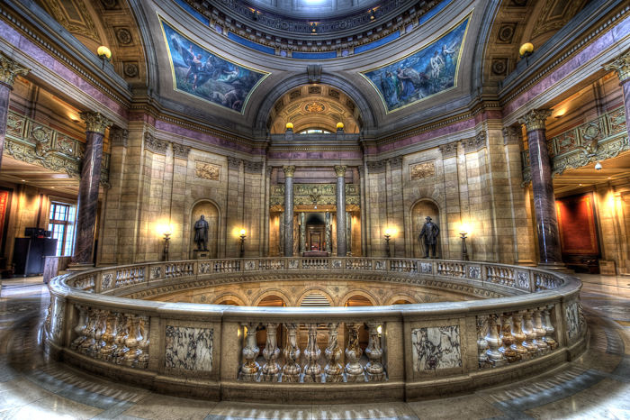
Public Accountability . . .
Notes:
· Task Force (purpose, review training specific recommendations, vision of expanding/solidifying partnership through the implementation process, key next steps)

Slide 8
Contact us
Tracy Crudo
tracy.crudo@state.mn.us
651-431-4669
Liz Snyder
snyde276@umn.edu
612-624-3779

