Slide 1
Flipping the Script on Leadership in Child Welfare
Mick McGuire
Angela Pittman

Slide 2
Notes:
4 year old, who we had an open INV on
Mom 20 yo,
20 YO BF, unrelated caretaker in the home and left with child caring duties
We had closed our INV, literally three days prior and got a call the child had blunt force trauma and would likely not live
Mom brought him to the ER
SWS and I there when Mom decided to take off life support
I knew the public wanted to hold someone accountable and wanted to make certain there was a message in our organization that we do not fail children! When in fact, that was exactly the wrong message to send - Mom’s BF had killed the child and the system of safety and community failed the child.
Then I began a course of action that continues to resonate in our organization today.

Slide 3
Leadership

Slide 4
2010 – Began learning about the model and providing some training and allowing it to grow organically 2012 – Resilient Workforce 2012 – Realization that practice Model aligns with leadership mindset shift - CPS wide Implementation begins 2015 – Utilized Article “Soft is Hardest” as guide through highly publicized fatality
Signs of Safety Introduction to Buncombe County

Slide 5
Key Leadership Practice Principles
Respect all “social workers/workers” as people worth “mentoring and coaching”.
Cooperate with the “social worker/workers”, not their crisis.
Recognize that cooperation is possible “even though you are their supervisor”.
Recognize that all “social workers/workers” have “strengths”.
Maintain a focus on “practice depth”.
Learn what the “social worker/workers” wants.
Always search for details.
Focus on creating small change.
Don’t confuse “details” with judgments.
Offer choices.
Treat “supervision and team meetings” as a forum for change.
Treat the “leadership” principles as aspirations, not assumptions.
Adapted from Turnell, A & Edwards, S (1999). Signs of Safety: A Solution and Safety Oriented Approach to Child Protection Casework. New York, NY: W.W. Norton & Company

Slide 6
Immeasurable Impact of One Question!
What is working well?
Notes:
Mick

Slide 7
There is no Crystal Ball!

Slide 8
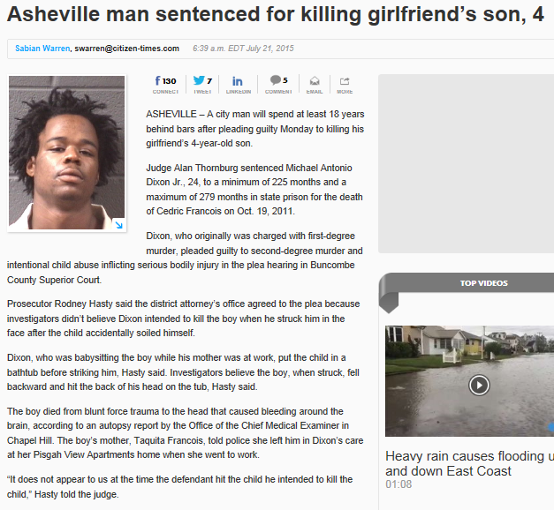
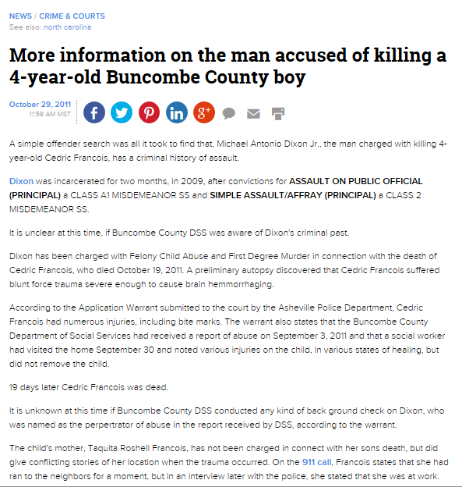
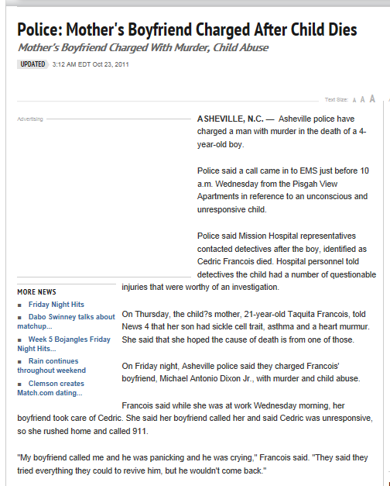
2015 Child Death vs. 2012 Child Death as experienced by Supervisor
Child Death vs. Child Fatality

Slide 9
Signs of Safety as a questioning approach
makes it okay to ask questions.
Why do we do things the way we do…. and does it make sense?
Leadership that is open to Listening paves the way.

Slide 10
What’s Different Now
Communication:
Staff with direct family/child involvement
All Social Work staff
Commissioners and HHS Board
Partners involved with the family/child
Public – media
Addressing Secondary Trauma:
Critical Incident Stress Management
Threat Assessment Teams
Individual Sessions
EAN or own therapist
Organizationally
Being proactive

Slide 11
What’s Different Now?
“Autopsy without blame”
Review of the “system” issues v. blaming the Social Worker
Use of mapping throughout this process
Other Outcomes:
Community Engagement (CCPT)
Community Service Navigators
Managed Care Organization
Medical Community
Mental Health and Substance Abuse Community

Slide 12
Leadership Lessons Learned
YOU do not have all the answers
When you fail, apologize
Supervisors are key
Lead through questioning
When you don’t understand, DIG
Be Fearless

Slide 13
"Press on: Nothing in the world can take the place of perseverance. Talent will not; nothing is more common than unsuccessful men with talent. Genius will not; unrewarded genius is almost a proverb. Education will not; the world is full of educated derelicts. Persistence and determination alone are omnipotent." -- Calvin Coolidge

