Slide 1
Overview of Child Welfare Reform in the U.S.
Center for Advanced Studies in Child Welfare 2016 Spring Conference
Crystal Collins-Camargo, MSW PhD
Kent School of Social Work
University of Louisville

Slide 2
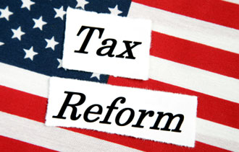
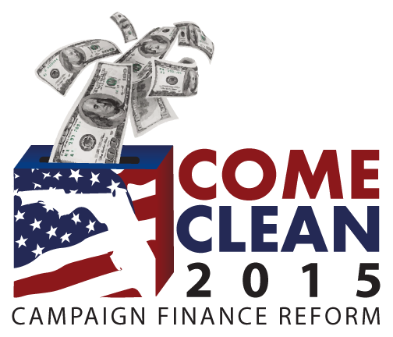
The Concept of Reform
Notes:
Coming from the land of the Kentucky Derby, I offer a depiction of a horse race,
Image regarding the “Reform Act of 1867 in England designed to double the number of “respectable working men” who were allowed to vote in that country—the debate over which was complicated by the results of our Civil War which promoted the expansion of democracy—a very scary concept to the British Gentry at the time.
When you hear the term “reform”—what types of reform are we most often hearing about in the U.S.
Images found on the internet bring to mind major systems, problems, entities we think need reform—tax reform, immigration reform, Campaign finance reform, health care reform

Slide 3
Merriam-Webster on Reform
“To put or change into an improved form or condition”
“To put an end to (an evil) by enforcing or introducing a better method or course of action”
Implies:
Target is an established process or entity we care enough about to try to change it
Something is wrong with it
The goal is to do a better job

Slide 4
History of Child Welfare
Roots of child welfare are in charity home societies and the private sector
Child welfare as we know it is about 40 years old
Federal footprint: 1974 Child Abuse Prevention and Treatment Act
Notes:
The private sector was intervening with families to address kids’ needs long before public agencies were involved
When I refer to “child welfare” I see this as not just the public CW agency—but the broader child welfare partnership among the public agencies serving families who have experienced child maltreatment or risk of it—recognizing that this is not an equal partnership and the public agency has the mandate and is seen as bearing the majority of the responsibility
We are about 40 years into what we now think of as the CW system. In the life of a “system”—an institution—we are but teenagers experiencing all of the growing pains, and wonder and angst that goes with that stage of development.
After the ’60s saw the illumination of the problem of child maltreatment states started responding. With the federal legislation in 1974, standards began to be set

Slide 5
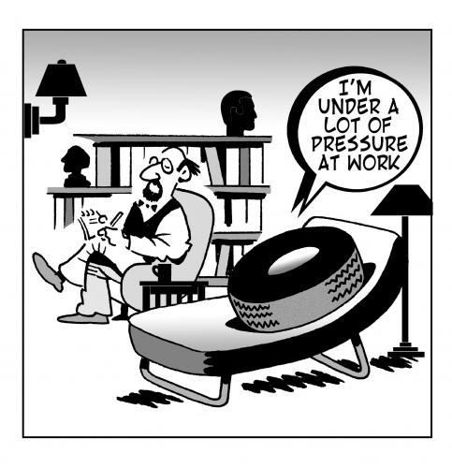
Why Are We Compelled to Reform the System?
Notes:
Anyone who has worked in this system for long feels the pressure

Slide 6
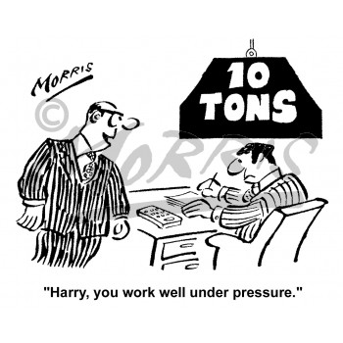
Multi-directional Pressure
External Influences
Internal Drive
Media scandal
Push from partners and stakeholders
Budget cuts
Governors and legislatures
Our outcomes are not what we want
Repeat maltreatment
Re-entry
Aging out without permanency
Well-being over the long term
Continuous quality improvement and emerging research
Notes:
This comes from external sources including media attention and rising public concern, budget-driven cuts that jeopardize services, and twhen policy-makers insert themselves into the work by mandating change.
This external pressure is often like this.
I like to believe, however, that much of our reform is driven by our own internal desire to do a better job for kids and families.
We see our outcomes and our failures
We look at our own data and examine what it means, we consider what research tells us might be a better way.
This sort of pressure looks more like this.

Slide 7
Types of Reform We have experienced

Slide 8
The Evolution of CW Reform—Four Types
Philosophical approach
Legislative mandate
Responsible party
Practice techniques and models
Notes:
There are many ways to think about the waves of reform we have experienced—some of us have experienced more waves than others.

Slide 9
Philosophical Approach
Child saving vs. family preserving
Investigation vs. assessment and treatment
Child welfare as a community responsibility
Safety, Permanency AND Well-being
Systems of Care—family-driven and youth-guided care
Notes:
In our infancy as a publicly mandated system we fell into a quasi-law enforcement approach. Over time we have shifted from a child saving to a family preserving system, as the pendulum swung back and forth.
We focused on honing our investigative skills, and then we realized that to really help families we needed to emphasize assessment and treatment
Awhile after public agencies were largely bearing the responsibility alone we evolved to thinking about chidl welfare as more than child protection—and that it was truly a community responsibility.
Although it was institutionalized in federal legislation—we evolved from a focus on child safety, to permanency, and then well-being. It isn’t enough to try to keep kids safe. Today we still struggle with how to integrate these three outcomes, and who is responsible for this incredibly huge job.
The systems of care movement has been a tremendous force for good in child welfare. The built in values of family-driven and youth guided care has pushed us to rethink our approach.

Slide 10
Legislative Mandate
Shifts in the law is a response…to philosophical shifts, scandal, ideas or evidence
1974 Child Abuse Prevention and Treatment Act
1978 Indian Child Welfare Act
1980 Adoption Assistance and Child Welfare Act
1994 Multiethnic Placement Act
1997 Adoption and Safe Families Act
2008 Fostering Connections to Success and Increasing Adoptions Act
2011 Child and Family Services Improvement and Innovation Act
Notes:
1974 Child Abuse Prevention and Treatment Act –Federal legislation allocating funds for improvement of state responses to reports of CAN as over the past few years states had been estabilshing reporting laws and struggling to develop service delivery systems, setting standards in place—later reauthorization has instituted accountability measures such as the establishment of Citizen Review Panels
1978 ICWA—response to a history of removing Native American children and placing in non-Indian homes and institutes, imposing cultural change
1980 Adoption Assistance and Child Welfare Act—concern about lanquishing in foster care—states required to make “reasonable efforts” to prevent placement and reunify families; permanency plans and judicial review, time frames for decision-making regarding the move to adoption
1994 Multiethnic Placement Act—designed to lower barriers to adoption for children of color—later amended to narrow the circumstances in which race could be considered
1997 Adoption and Safe Families Act—correcting the course that may have overemphasized family preservation—set child safety as the priority, imposed stricter timelines for permanency—Safety, permenency AND well-being
2008 Fostering Connections to Success and Increasing Adoptions Act—shone the light on the need for lifelong connection, re-emphasizing relatives, services for transitioning youth, expanding adoption assistance
2011 Child and Family Services Improvement and Innovation Act – emphasis on attention to social and emotional wel-being and relationship to behavioral health. Title IV-B plans must include monitoring and tx for emotional trauma, use of psychotropic meds; standards for monthly case worker visit
The horizon— human/child trafficking; possibility of Title IV-E Reform and shifing the way we think about residential treatment

Slide 11
Responsibility for Child Welfare
Privatization or public/private partnership
Performance-based contracting
Co-opetition
Role of the community
Neighborhood centers informal supports
Differential response systems
Collective impact

Slide 12
Practice Techniques and Models
Flavor of the month or promising practices?
Forensic interviewing
Risk and safety assessment tools
Practice models
Trauma-informed care
The evolution of evidence-based and –informed practices
CQI and data-informed decision-making
Notes:
Evolving practices—remember we are teenagers –but we are also trying to build planes while we are flying them. I was tempted to include family engagement on the list of examples of techniques but I find this as a “new” concept insulting as an old child welfare worker. Perhaps we have renewed emphasis.
2008 Rick Barth wrote “As CW researchers, managers, and advocates the EPB movement cannot be ignored. The logic behind the saying “you can ignor politics but it won’t ignore you ‘ could also be applied to EBP.”—basically he advocated that we can either step up and deveop evidence to support our work and drive the discussion of what is worthy of attention—or it can be done to us.
Today the California Evidence-based Clearinghouse for Child Welfare now has 338 EB Programs who have met their criteria across 42 topic areas—admittedly going well beyond traditional CW practice to treatment modalities for adults and children, etc..
Our techniques and models are not restricted to frontline practice –organizational strategies have also evovlved such as continuous quality improvement

Slide 13
After 40 years, what have we learned about reform?

Slide 14
1. Lessons Learned
Reform driven by scandal and abrupt policy dictates is rarely successful
Notes:
We are often handed a mandate with a short timeframe for implementation
When I was the director of the QIC PCW and we had spent a few years studying PBC in child welfare states would call me and say the governor has mandated we institute PBC—or privatize our foster care system—what should we do? We have 90 days.
We often misunderstand what is actually contributing to the problem and therefore build misplaced initiatives. EXAMPLE--DARE

Slide 15
2. Lessons Learned
Data informed analysis of the actual problem, potential solutions and outcomes to be achieved is critical
Notes:
If we don’t do a thorough problem analysis we make assumptions about what is causing the problem and often end up headed in the wrong direction. KY DCBS used to employ a child welfare researcher who provided an excellent example of this. Our state was (actually we are again) experiencing a growing increase in the number of children in out-of-home care. The agency’s first response was to look at why we were removing so many more kids. What could we do to slow the flow of kids coming into care? Was it because workers were concerned about liability so erring on the side of safety? Did we need to contract for more family preservation services?
Data analysis revealed the rate of removal was unchanged. Any idea what was happening? We were not getting kids to permanency. Once they came in, they weren’t leaving care—this required a totally different solution obviously.
Clarity in desired outcomes is also important. In the state of IL they put PBC in place for private foster care agencies and incentivized permanency achievement. Sounds like the right idea, right? Well, they found that it was easier and quicker for private agencies to move kids to some types of permanency than others so more kids were moving toward adoption than should have. They had to right the ship by changing the performance indicators to to incentivize the right permanency decisions for individual kids.

Slide 16
3. Lessons Learned
We are strongest when we work with our partners
Notes:
The public agency should not be standing alone trying to protect children and families. What I learned in my work with the QIC PCW was that systems that built on the strengths of both the public and the private sectors through collaboration were the strongest.

Slide 17
4. Lessons Learned
Implementation matters
Notes:
This image almost says it all.
The best ideas, and sometimes the simplest tasks fail because we don’t pay attention to drivers of successful implementation. We train new practices with a spray and pray approach. We write policy and expect staff to fall in line. We need to pay attention to coaching and supervision, decision-support data systems, the support of external partners and organizational culture

Slide 18
What Remains to be done?

Slide 19
Child Welfare Finance Reform
We will continue to develop better, more responsive and more effective practices but how do we pay for it?
Notes:
We must move away from a funding strategy that is built on AFDC eligibility from the 1970’s
We must build funding strategies that reflect our understanding of the importance of prevention and front-end services not OOHC
We must think about ways to blend and braid funding in a sustainable way that recognizes a broader responsibility for a system of care for children and families
We must also implement valid and reliable approaches to measuring the real costs of service delivery

Slide 20
Genuine Public/Private Partnership
How can we engage in authentic partnership when we are involved in a contractual relationship?
Notes:
Imbalance of power in contractual relationships can make it difficult to be partners.
Stringent procurement policies that may make sense for the transportation department can prevent the collaborative visioning and planning our system needs
Co-opetition is a very complex dynamic—depending on the size and diversity of the provider pool and the need for services, private agencies are competing with eachother at the same time we are asking them to collaborate. Public agency administrators need to appreciate this complexity in their provider network.

Slide 21
Integrated, Sophisticated Decision-Support Systems
How can we effectively serve families if we don’t use the data available to us and our partners to understand what works and what we need?
Notes:
I don’t know about MN, but in KY we have a lot of data regarding our child welfare system and the clients we are serving. I mentioned we used to have a CW researcher—we actually had a team—we don’t anymore.
We are just now implementing standardized screening for trauma and behavioral health needs and the use of a standardized functional assessment by behavioral health providers to idetnify needs, select services, and monitor progress. I have been fighting for 2 years to get the agencies to embrace an approach that funnels these data into our SACWIS system so we can analyze what works and what we need.
How long have we been talking about having the CW system “talk to” the Court’s data system, the Dept of Education’s system, the Medicaid database? At least in our state we still operate independent systems that do not meld well together. We do not systematically integrate these data.

Slide 22
Reality check: Lessons from 40 Years of Education ‘Reform’
Set high academic standards for all of our kids, supported by a rigorous curriculum
Translation: Set desired child/family outcomes, supported by practice models designed to achieve them.
Greatly improve the quality of teaching in our classrooms, supported by substantially higher compensation for our best teachers
Translation: Implement effective child welfare practice, supported by a qualified, competent and appropriately compensated workforce and flexible, reasonable funding mechanisms
Measure student and teacher performance on a systematic basis, supported by tests and assessments.
Translation: Measure client, worker and organizational performance, supported by systematic program evaluation and practice-informed research
Increase “time on task” for all students; this means more time in school each day, and a longer school year.
Translation: Redirect our focus on the collective impact of child and family serving agencies in improving child and family well-being, working in collaborative partnership
Source: Gerstner (2008) Commentary in the Wall Street Journal. http://www.wsj.com/articles/SB122809533452168067
Notes:
After writing the overview article for CW360 and beginning to think about this presentation, I did what academics typically do when they don’t know where to start—I went to the internet, and found a 2008 commentary in the WSJ entitled “Lessons from 40 Years of Education Reform”. In it, Gerstner identified 4 things our educational system knew needed to be done but had failed to do to date. I don’t necessarily agree with what the author was proposing as a strategy to get to this done, but I think the four points have a child-welfare application that fits with what we have been discussing.
Read items and the CW translations.
I don’t think there is much disagreement in our field about these things that we must do

Slide 23
Borrowing from Maslow
Notes:
. It is up to us to figure out how to get there from here. It would be very satisfying to get to the point when we are no longer using the term “reform” when discussing the child welfare system but instead can focus on “enhancement”.
It struck me that it may be somewhat like Maslow’s Hierarchy of Needs. I believe child welfare is beyond the basics—physiological needs, and do a pretty good job much of the time on safety. Perhaps we are making progress on belongingness(permanency) and are just beginning to work harder on esteem (wellbeing) and we need our partners for this. We need to get to self—or perhaps system actualization. (creativity, spontaneity, problem solving, lack of bias)

Slide 24
Comments and Questions
Now’s your chance—what have I missed?

