Slide 1
Housing as a platform for child & youth well-being
CACSW 18th Annual Spring Conference
Ruth White, National Center for Housing and Child Welfare
Notes:
I’m honored to be here. I read Ryan’s book, No House to Call my Home. I suggest you all do too. It is a tour de force, and provides a front row seat to the unimaginable life in a group home. I’m so grateful for the insight he offers in this book.
I’m also humbled to be invited to this state where you have some downright celebrities, whose work has advanced housing policy and child development initiatives for the rest of the country – such as well, the Center, Cathy ten Broeke, Ann Masten. Wilder Research, of course is also a force to be reckoned with. It is a real honor to be here.

Slide 2
Our Work
NCHCW links housing resources to child welfare agencies to improve family functioning, prevent family homelessness, safely reduce the need for out-of-home placement, and ensure that each young person who ages out foster care is able to access safe, decent, permanent housing.

Slide 3
Overview of my remarks
The landscape of affordable housing/homelessness
Evidence of the links between housing and well-being
How does this impact child welfare agencies?
What can child welfare do to improve housing, prevent homelessness among families and youth?
Who can child welfare agencies partner with to access a range of housing resources?
Q & A

Slide 4
Homelessness in America
According to HUD’s annual homelessness report (2016) 194,716 people in families with children experiencing homelessness each night in the U.S.
Over 1.2 million students were identified as homeless in the 2014-2015 school year, a 34 percent increase since the end of the recession in the summer of 2009.
HUD reports that each night 35,686 unaccompanied homeless youth, 11 % of whom are under age 18.
Wilder Research tracks these figures in MN, specifically. This is your best resource for such data.

Slide 5
Everyone is living in their parents’ basement
It is not just youth aging out of foster care who face housing challenges when they reach adulthood.
Housing is now so expensive (or perhaps living wage jobs are so scarce) that living with parents for the first time is the most common living arrangement among 18-34 year olds in the U.S.
Courtney, et. al. (2011) shows that even when former foster youth are working their average annual income is less than $8,ooo.

Slide 6
America’s affordable housing crisis
The lack of affordable housing is not the only cause of homelessness, but it is a major problem nationwide.
In 2014, a record high, 11.4 million households paid over half their income for housing.
According to the National Low Income Housing Coalition, there is no community in the US where a two bedroom apartment is affordable to minimum wage earner.
The hourly wage necessary to afford the average two bedroom apartment in the U.S. is $20.30.

Slide 7
Housing instability has a predictable impact upon child and youth well-being
A 2015 study found that the younger and longer a child experiences homelessness, the greater the cumulative toll of negative health outcomes.
Homelessness is associated with an 87% increased likelihood of dropping out of school.
States have found higher drop-out rates and lower graduation rates for homeless youth compared to housed, poor youth.
Data from the Youth Risk Behavior Survey show that youth experiencing homelessness report significantly higher rates of victimization, hunger, PTSD, exposure to violence, and suicidality than other students. These factors are predictive of adverse well-being and productivity outcomes later in life.

Slide 8
Housing Impacts Families all along the child welfare continuum
Housing affects families at each decision point in the child welfare continuum. Children from families with housing problems are:
More likely to be investigated by CPS (Culhane et al, 2004)
More likely to be placed in out-of-home care (Courtney et al, 2004)
Longer stayers in foster care (Jones, 1998)
Thirty percent of children in foster care are there because of housing problems (Doerre & Mihaly, 1996; Hagedorn, 1995; Thoma, 1998).

Slide 9
How does all of this impact the Child Welfare system?
Child welfare agencies are “catch all” bureaucracies
Most neglect statutes include housing
All but 13 states have the inability of a caregiver to provide shelter as a part of their state definition of abuse and neglect.
Nine of these states exceptions for families who are unable, due to economic reasons to provide shelter for their families from being charged with neglect. ***Washington state incudes an exemption for economic problems as well, even though housing is not included in the neglect statute.

Slide 10
Housing is a prudent child welfare investment
A $15 million investment in FUP means that more than 9,000 children can return home. This will result in a savings of $101 million in foster care expenditures. (Harburger and White, 2004). (or $56, 892 per family)
It costs approximately $53,500 to serve a homeless young person on the street or in residential treatment but supportive housing for one young person costs only $5,300. (Van Leeuwen, 2004).

Slide 11
Housing versus “flex funds”
Sustained economic investments make the difference – in cases of great financial stress, a small handout or purchase of equipment may not tangibly improve the plight of families. (Littell and Schuerman, 2002).
families who received housing subsidies improved their circumstances, while families who received cash assistance continued to have problems. In order to get cash assistance, you have to continue to report problems. This is not the case with housing – it is quite the opposite.

Slide 12
Half of federal child welfare dollars are tied to out-of-home placement
… but half are not. Some states use these flexible dollars to subsidize rent, etc.
Source: FEDERAL, STATE, AND LOCAL SPENDING TO ADDRESS CHILD ABUSE AND NEGLECT IN SFY 2012 (Urban Institute, 2016)

Slide 13
What can child welfare agencies do to improve housing, prevent homelessness
Partner with housers for diversion and homeless prevention.
Research shows that homelessness and poor housing quality trigger investigations, but not removals.
Train workers to prevent homelessness (they have an advantage that shelter workers do not).
Participate in conversations governing the distribution of community housing resources.
Maximize child welfare resources to prepare ALL older youth in care for economic self-sufficiency, including savings accounts.

Slide 14
Recommendations from Cathy ten Broeke
Increase housing options for youth and housing that provides support to family and kids.
Support for families in poverty to stay in their homes.
Help the natural support system in a young person’s life, like a loving, trusting adult that can stay connected and perhaps provide housing stability.
Address issues for kids coming out of the child welfare system or foster care.
-From Cathy ten Broeke (2016)

Slide 15
Prediction, forecasting, and… knitting to eliminate gaps in housing for older youth

Slide 16
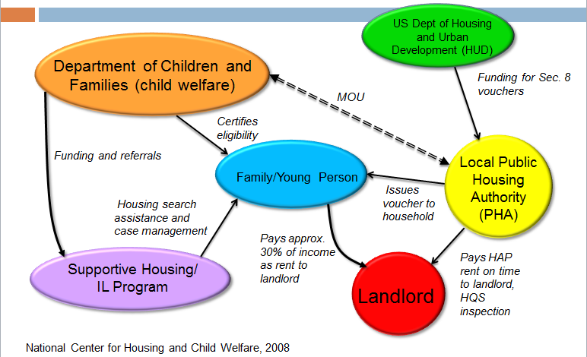
Housing – Child Welfare Partnership Model

Slide 17
Leave no stone unturned when it comes to housing resource
Rapid Re-Housing Program
Permanent Supportive Housing
Community Action Programs
HOME
Low Income Housing Tax Credit
City and State housing funds, SHFAs
Private Landlords
Public Housing Authorities – Section 8 and PH
Family Unification Program

Slide 18
Some final thoughts on where to start
Pay a visit to the states that have made strides, learn from their mistakes and achievements.
States can use some homeless services and housing dollars for youth, but again, there are restrictions.
Collaborations are the fastest, most efficient way to create a range of housing options.
You can always contact the National Center for Housing and Child Welfare with questions or for training!

Slide 19
Contact information
Ruth White, MSSA
Executive Director
National Center for Housing and Child Welfare
4707 Calvert Rd
College Park, MD 20740
(301) 699-0151
rwhite@nchcw.org
www.nchcw.org

