Slide 1
Family Connections Linking Parents & Family to Support Children in Care
Notes:
Introductions

Slide 2
Re-Thinking Family Involvement
Shifting the default from Why we can’t to Why can’t we?
What would we want done in our own family? What would we do for our own family?
Are we holding family members to different (usually higher) standards?
Assessing risk vs. safety (red flag vs. red light)
Slide 2
Notes:
How often have you seen family members get passed by, ruled out, removed from a case, very quickly or for frivolous reasons?
We would want to be given the benefit of the doubt! We would want an opportunity to change things!! We give foster parents the benefit of the doubt but why not family.
These are talking points to use with teams and families directly. (old way of thinking vs. new way of thining)
URGENCY, every night in care is a night in crisis
Children have had several team members
- There are some family members who have broken promises
- Child may be wondering if the relatives will stick around.
There may have been a lack of time since the child has seen family
Through the child’s time in care, the child may have spent a considerable amount of time with individuals other than family and built close relationship.
The child has gone through various treatment, diagnoses. The labels follows the child.
The family may be ill-equipped to deal with child’s behavior or treatment.
Residential facilities: Requirement for visits to begin may be phone calls first, a series of on-campus visits, then off campus visit with therapist involvement along the way.
Distrust has developed between the team and family
Child loses existing relationships with family
Child has developed close bonds with foster family
Labels, diagnoses, child perceived as “fragile”

Slide 3
Power Dynamics
Parents may be experiencing:
Fear
Distrust
Defensiveness
Guilt / Shame
Professionals enter with:
Intimidating physical presence
Confusing language
“Expertise”
Savior mentality
Personal bias
Notes:
Imagery Example? “Imagine you just had your children taken away….”
Intimidating Language:
“assessment, appropriate, investigation, court-appointed, home study, requirements, perpetrator, permanency”

Slide 4
Power Partner Dynamics
Every youth has family members that are able and willing to care for and support them.
Everyone has something to contribute, regardless of their history, background, or opinion of the situation.
Every family is unique, and so only the family members themselves are experts on the family.
Family members likely don’t have the knowledge or tools to reach out to us. It’s our job to find them.
Abandoning the savior mentality.
Notes:
Family is also those who the family tells us is there family, not just blood relatives.

Slide 5
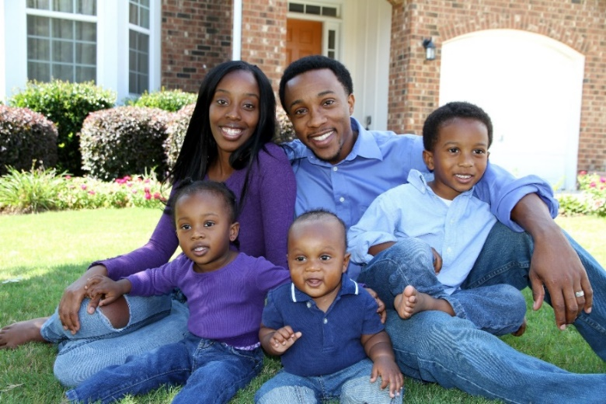
What is 30 Days to Family®?
An intensive and fast-paced 30 day search for relatives & kin beginning at the time a child enters protective custody
Notify relatives and identify placement options
Outline a network of relative supports and connections that promote stability and family involvement, outside of placement
Notes:
“We get in there at the very beginning, identifying every single relative and notifying them” “From the very beginning instead of waiting”
Briefly mention eligibility, case load

Slide 6
Replication of 30 Days to Family®
Ampersand began replicating the model in Minnesota in fall 2021.
Part of the Kin Link program.
Children have the right to remain connected to their people!

Slide 7
Professionals are the Bridge
Workers have the ability to set a tone of empowerment, valuing strengths, and collaboration towards success.
Lean on culturally-relevant community partners, collaborate!
Seek out consultation and fresh perspectives.
Remember our shared passion!
Notes:
Lean on other professionals in this field, especially culturally-relevant community partners
We can not do our best work siloed; we must collaborate for benefit of whole family
This is high stress work fraught with vicarious trauma, when we work together, we relieve the pressure on ourselves to make huge decisions
Search out consultation and fresh perspectives
We are all here because of our shared passion for doing right by children and families!

Slide 8
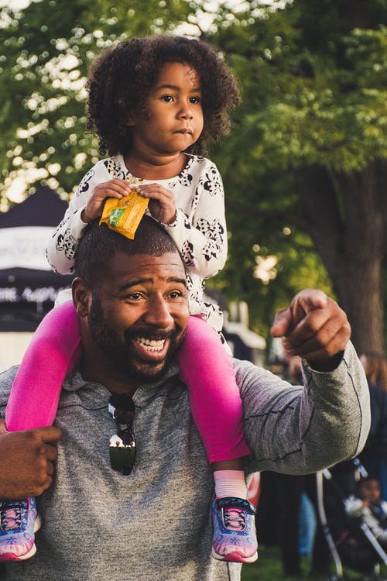
Honoring Parents
Unpack the term “birth parents.”
Don’t forget dads!
Help parents navigate the gravity of the process with empathy and acceptance.
Be advocates for systems change!
Notes:
Use strength-based approach, remember families and parents are overwhelmed, tired, and frustrated they are going through one of the worst experiences of their lives.

Slide 9
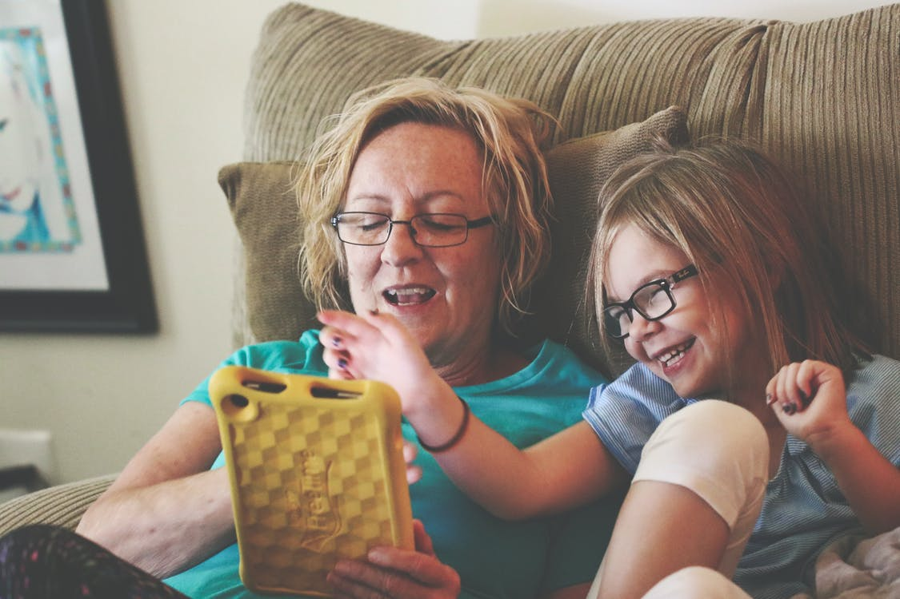
The Child is Placed with Family, Now What?
Build strong and sustainable layers of support – “who, what, when, where…”
Assist in initial conversations between the parents and the family supports.
Natural family supports will be around after reunification and are what parents need for long term success!
Notes:
We are partnering with families, laying the groundwork with them so they can take care of each other
Assist in facilitating conversations, recommend specific resources such as family therapy or support groups
Build natural supports plan, be specific about who, what, when and where supports are being offered
Be intentional in connecting relative/kin foster placement with those family members offering support

Slide 10
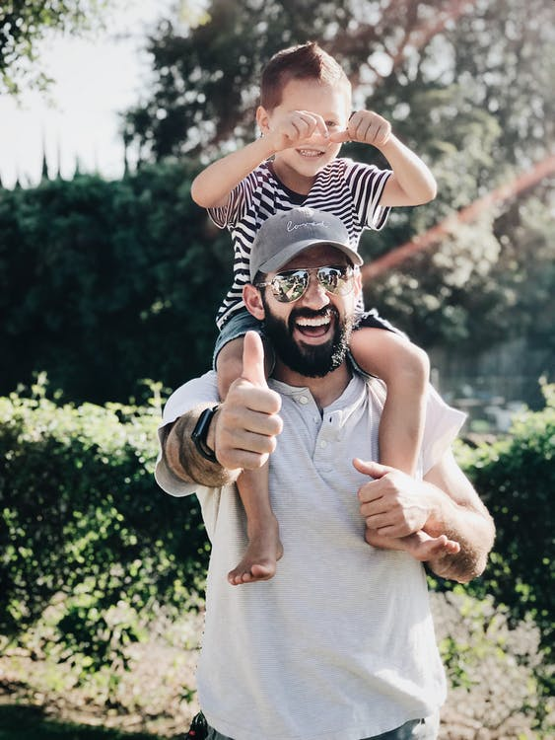
Resources for Families
MN Adopt- HELP navigators can assist kinship families with things such as therapists, education
NACAC- support groups
LSS kinship navigation- support groups, warmline for kin
MN One Stop for Communities- parent mentors
NAMI Family Groups
Village Arms- family liaisons, advocacy for African American families
Family Rise Together- family mentorship and support groups

Slide 11
Questions?
jada@forchildwelfare.org patrick@forchildwelfare.org
©2022. The Institute for Child Welfare Innovation. All rights reserved. Reach us at forchildwelfare.org
Notes:
Family Engagement: Partnering with Families to Improve Child Welfare Outcomes
Child Welfare Information Gateway----July 2021
https://www.childwelfare.gov/pubPDFs/f_fam_engagement.pdf

