Slide 1
It’s possible: cultivating positive relationships between birth and foster parents
Ericka M. Lewis Ph.D., LMSW
CASCW 2022 Annual Spring Conference
April 20, 2022

Slide 2
Acknowledgments
Collaborators:
Youth Law Center
Quality Parenting Initiative
QPI Sites Leads
Foster and Birth Parents
Funding Support:
Annie E. Casey Foundation

Slide 3
Presentation Overview
Discuss the Importance of Stakeholder Relationships in Foster Care
Describe QPI and Its Impact on the Birth and Foster Parent Relationship
Identify Strategies to Promote Positive Working Relationships Across Stakeholders

Slide 4
6th Annual QPI National Conference Philadelphia, PA April 30, 2019
Building a Relationship Based System: Techniques for Transformation
Notes:
-Presentation is right before the reception
Building a Relationship Based System: Techniques for Transformation
Conference Word of the Day = RELATIONSHIPS
Opener
Discuss missing the conference because of the weather (Ice Storm of 2018)…soooo glad the weather won’t keep us apart
Jennifer Rodriguez Mantra
Our goal is to improve the lives of children
Foster care children & youth are happier while in care
In order to do this, there MUST be better partnerships and relationships between bio/foster parents, agency staff, and community partners

Slide 5
Foster Parents As Stakeholders
In 2020, over 407,000 children and youth were placed in foster care¹
Foster families provide stable living environments, where children can develop secure attachments and form trusting relationships with caregivers
Quality foster care is associated with better child outcomes^{2,3}
Decreased high risk behaviors
Increased feelings of safety and overall well-being
Notes:
” (U.S. Department of Health and Human Services, 2021).
2. (Schoefeld & Beek, 2009).
3. Storer et al., 2014)).
The argument is that when Foster Parenting is delivered with quality, foster parents children can build secure attachments, which leads to better outcomes.

Slide 6
Cultivating Working Relationships Among Foster Care Stakeholders
When positive relationships exist between foster parents and agency personnel, foster parents are:
more involved in the work
satisfied in their role
encouraged to continue to foster
The quality of the birth and foster parent relationship can impact:
birth parent and child outcomes
family reunification
Notes:
” To ensure effective care coordination for youth in care, foster parents must develop and maintain working relationships with birth parents, foster care agency personnel, and other stakeholders.”
It is usually in the child’s best interest for birth and foster parents to maintain supportive relationships
“Given the role of foster parents in providing continuity of care and promoting child well-being, many child welfare agencies are keen to identify strategies to improve the working relationship among child welfare services stakeholders and ensure foster parent perspectives are valued and incorporated in quality improvement efforts.”
The quality of the relationship between birth and foster parents impacts family reunification outcomes. As such, it is imperative to explore strategies to engage foster parents as invested and valued caregivers, and to equip them with the skills that improve their coparenting relationship with birth parents.
Therefore, A better understanding on how to strengthen this relationship is important and can lead to the development and testing of strategies to improve foster parent well-being and retention.

Slide 7
Stakeholders Drive Change
Parenting and Meaningful Relationships are Important Services to Children in Foster Care
Children Need Excellent Parenting
Notes:
Parenting- Consistent, excellent parenting and meaningful relationships are the most important services to child and youth in foster care.
Meaningful Relationships- Research on child development and trauma demonstrates the importance of parenting and positive relationships.
Stakeholders Drive Change
“Quality Parenting Initiative (QPI) is a systems change approach designed to expressly address the practices of foster parents and their support from child welfare workers, by helping agencies and systems incorporate best practices and policies.” It is a collaborative approach
This is the commitment to excellent parenting through strong relationships that put the child first.
Stakeholders must be involved in every stage of the change process while QPI provides strategic consultation and organizational support by working with its stakeholders to develop an implementation plan, as well as implementation and advocacy resources to support sites in their work.
QPI draws heavily of diverse stakeholders and the is unique due it the intensity of the focus of partnership, meaning Less guidance is provided on skills to promote shared parenting and other strategies that build trusting relationships between out-of-home caregivers and parents of youth in foster care.

Slide 8
QPI Supported Activities
Partnership Plans
Improved Transition Planning
Comfort Calls
Notes:
Comfort Calls: are arranged phone calls that are placed by the foster parent to the birth parent immediately following a new placement.
Partnership Plans: are created by foster parents and case workers at the beginning of a new placement and outline various expectations related to mutual responsibilities, such as preferred forms of communication and information sharing
Improved Transition Planning: protocols developed to ensure that children are able to build as much of a relationship with the new caregiver as possible before moving, that the stakeholders share information about the child, that services and supports be put in place before the move, and that the child is able to maintain their relationship with the former caregiver after the move.
QPI has been implemented in over 80 jurisdictions in 10 states. Yet, no external research has been conducted to understand the implementation and impact of QPI.
The BFPP is a collaboration between Children's Trust Fund Alliance and YLC/QPI. Below is a description. Thanks!
The Birth and Foster Parent Partnership (BFPP) is an innovative approach that creates authentic partnerships among parents who advocate for policy and practices that benefit children and families. The BFPP is designed to further Casey Family Program’s (CFP’s) 2020 goals focused on the safe reduction of the number of youth in foster care. Its purpose is to increase coordination between birth parents and foster parent caregivers for improved permanency outcomes.
The partnership is managed through a collaboration between the Children’s Trust Fund Alliance (Alliance), Youth Law Center Quality Parenting Initiative (YLC/QPI) and CFP.

Slide 9
QPI Evaluation

Slide 10
Study aims
To assess foster parent perceptions of QPI satisfaction and usefulness
To explore perceptions of QPI’s impact on the foster parent experience:
establishing stakeholder relationships
strengthening stakeholder relationships
This Photo by Unknown Author is licensed under CC BY
Notes:
WHAT WAS STUDIED: The findings presented in this paper are part of a larger process evaluation study that assessed foster parent perceptions of QPI satisfaction and usefulness; explored strategies to engage diverse stakeholders in QPI implementation; and examined current efforts to measure implementation outcomes.
HOW: Snowballl Sampling
DATA COLLECTION: We collected data through qualitative interviews (in-person and over-the-phone). The interviewers were trained and supervised by an experienced qualitative researcher. Interviews lasted, on average, 53 minutes. A semi-structured interview protocol was developed to assess foster parent perceptions of QPI satisfaction, usefulness, and impact. Table 3 displays the main topics covered, with sample questions
ANALYTIC APPROACH: Thematic Analysis, which is ” method for identifying, analyzing, and reporting patterns within data”
ENHANCEMENTS TO METHODOLOGICAL RIGOR: Done 2 Ways, memo writing and reflexive discussions.
ADRESSING DIVERSITY: These reflexive discussions help challenge biases and prevent the imposition of the team’s expertise in child welfare on the data collected. Furthermore, the racial and ethnic diversity represented in the research team was useful in elevating the importance of cultural relevance of services and programming offered to foster parents.

Slide 11
Data Collection
Who?
Licensed Foster Parents
QPI Sites in Florida, Minnesota, and Louisiana
When?
May - August 2019
How?
Semi-Structured Interviews (in-person and over-the-phone)
Thematic Analysis
Notes:
WHAT WAS STUDIED: The findings presented in this paper are part of a larger process evaluation study that assessed foster parent perceptions of QPI satisfaction and usefulness; explored strategies to engage diverse stakeholders in QPI implementation; and examined current efforts to measure implementation outcomes.
HOW: Snowballl Sampling
DATA COLLECTION: We collected data through qualitative interviews (in-person and over-the-phone). The interviewers were trained and supervised by an experienced qualitative researcher. Interviews lasted, on average, 53 minutes. A semi-structured interview protocol was developed to assess foster parent perceptions of QPI satisfaction, usefulness, and impact. Table 3 displays the main topics covered, with sample questions
ANALYTIC APPROACH: Thematic Analysis, which is ” method for identifying, analyzing, and reporting patterns within data”
ENHANCEMENTS TO METHODOLOGICAL RIGOR: Done 2 Ways, memo writing and reflexive discussions.
ADRESSING DIVERSITY: These reflexive discussions help challenge biases and prevent the imposition of the team’s expertise in child welfare on the data collected. Furthermore, the racial and ethnic diversity represented in the research team was useful in elevating the importance of cultural relevance of services and programming offered to foster parents.

Slide 12
Sample Questions
Domain | Question(s)
QPI Knowledge | In your own words, how would you describe QPI?
QPI Involvement | What has your involvement with QPI implementation looked like?
QPI Impact | What are the agency practice and policy changes you have noticed as a result of QPI? Probe: What improvements have you noticed with birth parents? Stakeholders? Agency Support?
Notes:
Interview Guide
What are the agency practice and policy changes you have noticed as a result of QPI?
Probe: What improvements have you noticed with birth parents? Stakeholders? Agency Support?

Slide 13
Participants N=31
On average, parents were 43 years old (SD = 14.3)
White (n = 25)
Foster care experience $≤5 years$ (n = 19)
Foster care experience ≤5 years (n = 19)
Female (n = 25)

Slide 14
Findings
Challenging Biases and Assumptions
Open Communication
Role Clarification

Slide 15
Role clarification
[The birth parents] more receptive to me helping them…. They're able to [see] I'm not the bad guy that came and took their kids from them. I guess they're realizing that I'm here to work with them and help them get their kid back.
We met mom in the hospital. We were fixin’ to take her son home, and that’s hard for anyone. [My wife] introduced us, and she’s like, “We’d like to give you a hug, and we just want you to know that we’re here for you. We’re gonna love him until he goes back to you. If there’s anything you need along the way, you let us know.” We exchanged phone numbers. We said we would send her pictures and videos. She could call us. She could FaceTime. She didn’t have to
just see him that one time a week for the visit.
Notes:
“Participants discussed how QPI’s defining of the expectations of caregivers and communication of these expectations to all relevant stakeholders helped facilitate improvements in the birth and foster parent relationship. “
“Providing clarification on the roles and expectations of birth and foster parents from the beginning helped reduce potential tensions and facilitated relationship building.”
Role Clarification: a foster parent shared that QPI helped her birth family understand that her role is to provide them with support as they work towards getting their child back. Providing clarification on the roles and expectations of birth and foster parents from the beginning helped reduce potential tensions and facilitated relationship building.

Slide 16
Challenging Biases and Assumptions
We had the impression that we were just not gonna like this guy, and then we met him and immediately realized our first impression was off. We told him “You can call. You can text. You can whatever,” and along the way, we maintained that. He called every night faithfully to sing his son a lullaby. He did that for five months until [his son] went home…
[Agency staff] are making sure that we understand our role in it and actively engaging us and following up and saying, “Okay. How is your relationship with [the birth parent]? What would you need to make that better?” Our social worker would ask those questions. She would follow up and make sure that we were doing our part to work with the parents and have that open communication…
[The birth father] said: “I just wanna thank you because you treated me like a father. You never treated me like someone who lost his son because he was a bad guy [and] because he did these things… You along the way treated me like a person, and you allowed me to be his father.”
Notes:
“Foster parents discussed how QPI also enabled them to acknowledge and address biases that they held about birth parents. “
“In addition to challenging biases and assumptions, foster parents shared that QPI helped them appreciate birth parents’ experiences and develop a sense of empathy for them. They shared that this empathy has affected the way that they engage with birth parents and that birth parents have acknowledged this shift. ”
“Furthermore, participants explained that QPI encouraged their efforts in providing support to their birth parents. “
Challenging Biases and Assumptions: Foster parents discussed how QPI also enabled them to acknowledge and address biases that they held about birth parents. appreciate birth parents’ experiences and develop a sense of empathy for them, and provided support to their birth parents.

Slide 17
Open Communication
The [birth] mom told me that she was really happy to be working with us because all of her friends were in the drug crowd and that drug scene that she was getting out of to get her kid back. She felt like she had nobody to go to anymore because if she went to her friends, she’d just fall back into that cycle. She said that that's been a really positive thing for her to be able to have us to talk to and be able to work with us and have that person to support her so that she's not in that crowd that she was before anymore. I think that [birth parents] getting a lot more support on their end to be more receptive of us and working with us more.
…once that child goes home, those parents have someone to rely on. They can always come back to you or reach out to you if they’re in trouble. We’ve built that relationship. They feel comfortable … where they would maybe rely on you to help them out in a bind when they need it…so that [their] child is not put in danger again.
Now it's like a relationship, almost a friendship, you know? I feel like that's definitely improved… It's allowed for more honesty, and this bio [parent] has shared more.
Notes:
QPI has had positive effects on their relationships with birth parents, specifically regarding communications and interactions.
Meets the best interest of the child, from the very beginning.
Participants also shared that the team-based approach was facilitated at the very beginning, after a child is removed
Foster parents did, however, identify the need to engage stakeholders from other relevant systems to make QPI even more successful at improving child outcomes by providing a holistic perspective of the child’s life. Specifically, participants recommended the judicial system, educational system, and foster care youth as stakeholder groups that need representation in the QPI process.
Role Clarification: a foster parent shared that QPI helped her birth family understand that her role is to provide them with support as they work towards getting their child back. Providing clarification on the roles and expectations of birth and foster parents from the beginning helped reduce potential tensions and facilitated relationship building.
Challenging Biases and Assumptions: Foster parents discussed how QPI also enabled them to acknowledge and address biases that they held about birth parents. appreciate birth parents’ experiences and develop a sense of empathy for them, and provided support to their birth parents.
Open Communication: QPI’s approach empowered birth parents to be more forthcoming with them about their circumstances and support needs, without fear of losing their child. They explained that through QPI, birth parents view them as an additional source of support that they can call upon in the future. QPI helped them realize that it is in the best interest of the child for all relevant caregivers to communicate effectively, work collaboratively, and get along, tension however, can adversely impact the child.
These foster parents recognized how the approach and values of QPI had a positive impact on the relationships they build with birth parents of the children they fostered. Participants shared that QPI provided a clear articulation of roles and expectations of caregivers and cultivated a team-based approach to meet the best interest of the child. Additionally, QPI challenged biases and assumptions foster parents held, and offered opportunities to develop empathy towards birth parents.

Slide 18
Discussion

Slide 19
Summary of Findings
QPI Activities, (e.g., comfort calls and icebreaker meetings) helped foster parents interact with birth parents in a supportive, non-judgmental fashion
QPI helped foster parents empathize with birth parents’ struggles and increased their efforts to communicate with birth parents
Actively sharing parenting power reduced tension between birth and foster parents
Notes:
QPI shifts power away from the agency-based professionals toward foster parents to improve outcomes for children.
Past research suggests that foster parent engagement with and support for birth parents can reduce parental tension and alleviate fears of having a child in the foster care system (Morrison et al., 2011; Nesmith, 2013; Nesmith et al., 2015).
. QPI also helped foster parents empathize with birth parents’ struggles and contributed to increase efforts to communicate with birth parents.
QPI sites have developed concrete activities to demonstrate these essential elements.

Slide 20
Future Directions for Practice
Create opportunities for “shared parenting” and more frequent interactions to build trusting relationships between birth and foster parents
Acknowledge and address the needs of foster parents serving as parental figures and professionals (i.e., Dual Role)
Develop and provide additional tools/trainings for child welfare workers
Notes:
study findings suggest that foster care agencies may benefit from incorporating strategies that promote frequent, positive interactions between birth and foster parents
It is usually in the child’s best interest for birth and foster parents to maintain positive and supportive relationships
Moreover, child welfare workers who are intent on helping to create such an environment may need additional tools and training on best practices for professionals to prepare foster parents to effectively engage with birth parents

Slide 21
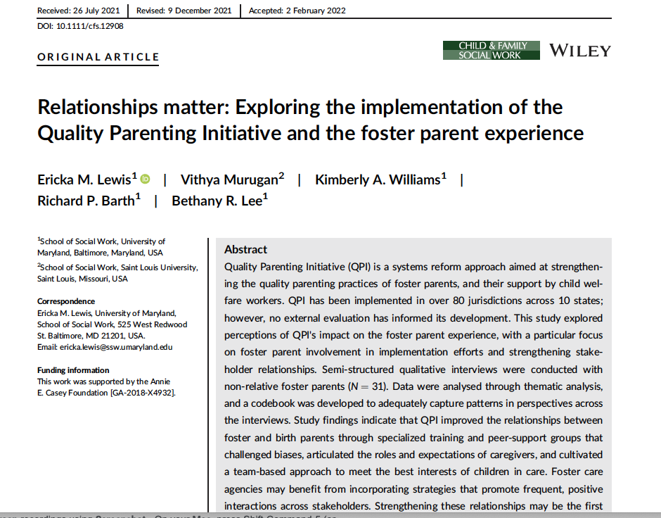
Lewis, E. M., Murugan, V., Williams, K. A., Barth, R. P., & Lee, B. R. (2022) Relationships matter: Exploring the implementation of the Quality Parenting Initiative and the foster parent experience. Child & Family Social Work.
Notes:
study findings suggest that foster care agencies may benefit from incorporating strategies that promote frequent, positive interactions between birth and foster parents
It is usually in the child’s best interest for birth and foster parents to maintain positive and supportive relationships
Moreover, child welfare workers who are intent on helping to create such an environment may need additional tools and training on best practices for professionals to prepare foster parents to effectively engage with birth parents
1. ” (U.S. Department of Health and Human Services, 2021).
2. (Schoefeld & Beek, 2009).
3. Storer et al., 2014)).

Slide 22
Thank you!
Contact Information
ericka.lewis@ssw.umaryland.edu

